Slide 1
LGBTQ Identity Development: Trends, Issues and Treatment Considerations
Laura M. I. Saunders, Psy.D. ABPP
Clinical Coordinator – The Right Track/LGBTQ Specialty Track
Young Adult Services
Institute of Living/Hartford Hospital

Slide 2
Presidential Politics
“A blind, bald, crippled, toothless man who is a hideous hermaphroditic character with neither the force and fitness of a man, nor the gentleness and sensibility of a woman.”
Notes:
In the presidential race of 1800 between John Adams and Thomas Jefferson, Jefferson called Adams “a blind

Slide 3
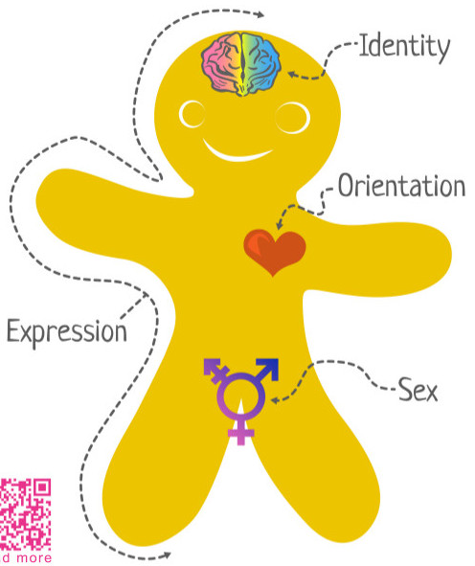
Terms & Definitions
Biological sex/natal sex – a category based on biological characteristics chosen to assign humans as male, female or ambiguously sexed.
Gender – A social construct used to classify a person as a man, woman, or some other identity. Fundamentally different from the sex (i.e. male, female or ambiguous) one is assigned following birth.
Core gender identity – internal feeling of being male or female, resulting from a combination of genetic and environmental influences.
Gender role – overt or covert societal expectations for how individuals of a sex are supposed to behave within a given culture (including setting and time point).

Slide 4
Terms & Definitions – 2
Gender expression - External manifestation of one’s gender identity, usually expressed through “masculine,” “feminine” or gender-variant behavior, clothing, haircut, voice or body characteristics
Gender variant/transgender/gender non-conforming – a person whose gender identity and/or gender expression varies from the culturally-expected characteristics of their assigned sex.
→a gender outside of the man/woman binary; no gender or gender fluid; gender queer
→ Gender dysphoria – clinical term when gender identity doesn’t match biological sex
→ Does not assume the individual is undergoing medical transition and will have sex affirmation surgery

Slide 5
Gender and Development
From: Joel Stoddard, MD, MAS, Scott Leibowitz, MDc, Hendry Ton, MD, MSa, Shane Snowdond (in press)
Notes:
Adolescence is a time for great social, biological, and psychological changes. For many young people, this is a confusing time fraught with unexpected twists and turns.
Most intense changes come during puberty, when the body undergoes physical growth and maturation.
Transgender youth seldom have support systems—they cannot find solace with peers and family in the changes happening to them.
Puberty is often the time when TRANS adolescents become the most confused and isolated.
Gender non-conformity in childhood may not have been taken as seriously by external systems, (Burgess, C. 2000)

Slide 6
Change for DSM V Gender Dysphoria
Marked incongruence between one’s expressed gender and assigned gender:
A strong desire to be of the other gender or an insistence that he/she is the other gender
In boys, a strong preference for cross-dressing or simulating female attire; in girls, a strong preference for wearing only typical masculine clothing
Preference for toys, games typical of other gender
Strong preference for playmates of the other gender
A strong desire for the primary or secondary sex characteristics that match one’s expressed gender
Condition is associated with clinically significant distress or impairment in
social or other areas of functioning.
Subtypes:
With a disorder of sex development *Separate criteria for Child & Adult
Without a disorder of sex development
Notes:
New criteria will identify stages of transition—social transition

Slide 7
Connecticut's Trans* Youth Population
CT has an estimated 92,775 (3.4%) of individuals identifying as LGBT (Gates, 2011)
Using this same rate as a guide one could estimate that 28,000 children in the state of CT already do or may soon identify as an LGBT individual or express the gender/sexuality consistent with this identity

Slide 8
Trans Healthcare
The Williams Institute shows that approximately 0.44% (12,400) of adults identify as transgender in the state of Connecticut,
0.57% (29,900) in Massachusetts, 0.51% (78,600) in New York, 0.43% (4,500) in New Hampshire, and 0.59% (3,000) in Vermont (Flores, Herman, Gates, & Brown, 2016).
The ability for these individual to access transition-related care is associated with reduced gender dysphoria and improved mental health and quality of life (White Hughto et al., 2017).
However, research shows that many trans individuals face structural (i.e., restrictive insurance policies), interpersonal (i.e., provider discrimination), and individual-level (i.e., education) barriers to health care, thus contributing to poor health (White Hughto et al., 2017

Slide 9
Persistent, Consistent and Insistent
Persistent – Gender dysphoria has existed over time
Ex: “I feel like I have a penis on the inside
and look like a girl on the outside (age 3)
Consistent – it is consistent across settings
Ex: Home, School, Social/Friends
Insistent – it seems to be driven from within
Ex: I “am” a girl on the inside vs. I think I want to be a girl.

Slide 10
Prevalence vs. Incidence
Are rates of gender dysphoria getting higher?
In the U.S. the # of people who identify as transgender has doubled in the last 5 years, up to 1.4 million
More trans identified people were killed in 2016 than any other time.
Families, peer groups, schools, places of employment are often ignorant or ill-equipped and as a result, isolated or ignore young GV
Need to shift focus from the gender identity as the “problem” to external factors (social pressure from popular culture, families, schools, peers groups, social service agencies)

Slide 11
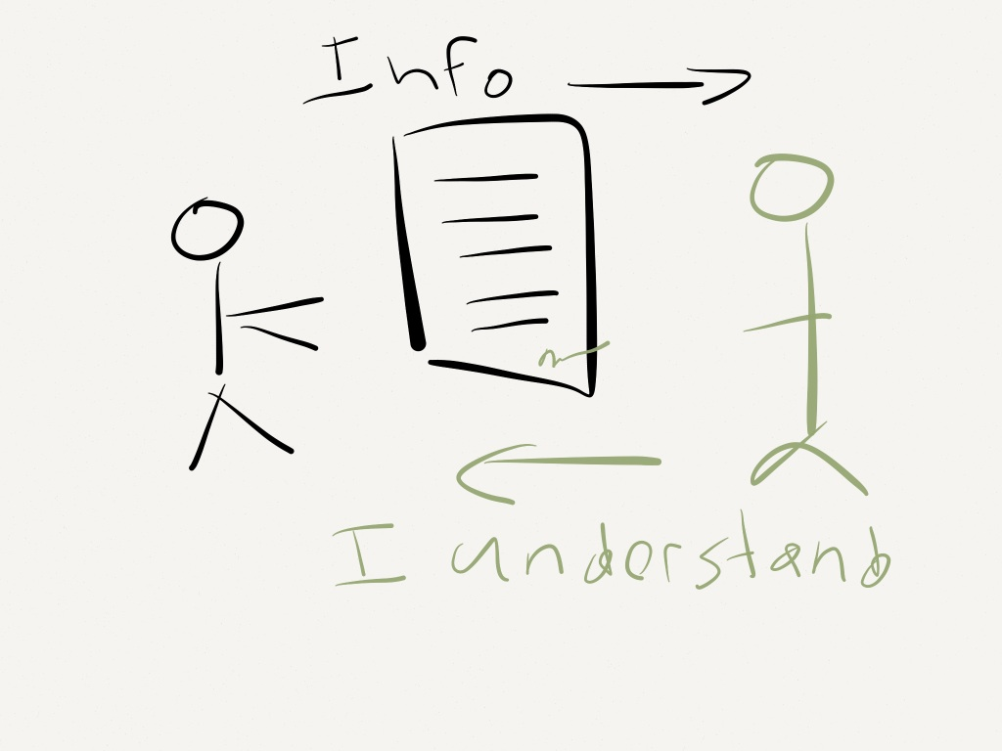
Trans Models of Care
WPATH (7th Edition, 2012)
Informed Consent
Medical Decision Making Capacity
Notes:
WPATH Pros and Cons - BH Recommendations are Vague, may seem like gatekeeping
Informed Consent - Creates access, minimizes undue assessment, typically does not account for psychological/lifestyle factors
Medical Decision Making Capacity - Creates access, identifies needs up front, assessment is broader but not burdensome (assesses understanding of tx options, risks and benefits, application to their situation, understanding how they reason about their tx, determining patient choice, appreciating cultural/value systems)

Slide 12
Summary of Risk Factors & Stressors Particular to LGB-GV Youth
Emotional distress/depression/suicide
Absence of role models
Isolation; minimal external support & validation
Internalized homo/trans phobia; numerous prejudices/stereotypes
Family conflict
Stigma/minority stress
Fear of verbal harassment & physical violence
School performance
Negative health outcomes
Notes:
For many reasons, the experience of gay, lesbian and bisexual teenagers is often one of isolation, fear of stigmatization, and lack of peer or familial support.
GLBT youth have few opportunities for observing positive modeling by adults due to the general cultural bias that makes GLBT largely invisible. It is this isolation and lack of support that accounts in part for the higher rates of emotional distress, suicide attempts and risky sexual behavior and substance use.
Thus it is important for their environments, especially their school environment, to be as open as accepting as possible, so these young people will feel comfortable sharing their thoughts and concerns.
To be able to provide an accepting environment, SCHOOL PERSONNEL need to understand the nature of sexual orientation development and be supportive of healthy development for all youth.

Slide 13
Risk factors for LGBT Youth: Prevalence of Negative Health Outcomes
Rates are higher for depression, suicidal ideation & attempts, substance use & sexual health risks
43% report a current depression
More than half (54%) reported at least 1 substance use related problem
40% reported at least 1 lifetime suicide attempt
As a whole, about half the sample of LGB adults demonstrate mental health and substance use problems
Ryan et al, 2009
Notes:
Additional findings: Sexual risk behavior appears somewhat less frequently but still a high incidence
Gender by Ethnicity outcomes/interaction: Latino men show higher rates of depression & suicidal ideation
Latino men – higher levels of HIV risk behavior
**Of note - 43% of sample report a current depression – Not a clinical sample this is the general population

Slide 16
Why LGBTQ are overrepresented in the mental health population
Three Layers of Additional Stress:
1. Minority Stress (Burgess, 2000)
Concealment, feeling invisible, hiding one’s true identity; microaggressions
2. Family Rejection
3. Social Stigma (Meyer, 2003)
Expectation of, or experiences of, being discriminated against based on identity
Prejudice as trauma

Slide 18
Additional Risk Factors – Queer Youth
Young adults who identify as “queer” were more than twice as likely to report lifetime suicide attempts.
Those who do not identify as gay or lesbian and identify as “queer,” may have most difficult struggle to find an authentic, personal sexual identity
Creates a lack of fit with LGB community and there are subsequent mental health implications based on inability to identify with gay/lesbian stereotypes, perceptions or expectations
Ryan , et al, (2010)

Slide 19
Mental Health of Trans Children who are Supported in Their Identities
Recent study published in 2016 in Journal of Pediatrics
Examined mental health of socially transitioned transgender children (ages 3 to 12; n= 73); compared to control group of non-transgender children
Results: Socially transitioned trans children have developmentally normative levels of depression and only minimal elevations in anxiety, suggesting psychopathology is not inevitable.
Olson, K, et al, Journal of Pediatrics, February, 2016
Notes:
Methods: A community bvased national sample of transgender, children (n = 73; ages 3 to 12); along with control groups of nontransgender children in the same age range (n=49 siblings of transgender participants); Parents completed anxiety and depression measures
CONCLUSIONS: Socially transitioned transgender children who are supported in their gender identity have developmentally normative levels od depression and only minimal elevations in anxiety, suggesting that psychopathology is not inevitable within this group.
NOTE: in Comparison to children with Gender dysphoria—socially transitioned transgender children have notably lower rated in INTERNALIZING PSYCHOPATHOLOGY than previously reported among children with GD living in their natal sex.

Slide 20
Names, Pronouns and other things
Reframe dress codes to describe what the school considers appropriate clothing without assigning clothing options to particular genders (for example: Many dress codes say, “boys pants and shorts must cover their underwear ; Girls pants, shirts or dresses must cover their underwear. “ Why not say, “all outer clothing (pants, shorts, shirts, dresses and the like) must completely cover all underwear”)
Eliminate gender based sorting of children (i.e. boys line up over here; and the like). Use other forms of grouping children (birthdays between January and June; everybody who is wearing something green, etc.)
Consider free choice play areas. If boys want to wear dresses and head to the housekeeping section, they are free to do so. If a girl wants to go to the construction site, do not discourage them.
Use of names and pronouns congruent with gender identity

Slide 21
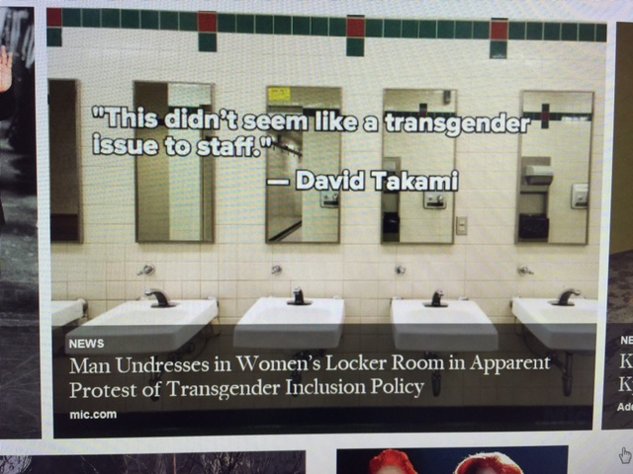
Bathroom Politics
Notes:
“A man in board shorts went into the facility’s women’s locker room to change around 5:30p. When pool staff were informed and demanded the man leave, he shot back saying, “the law has changed and I have a right to be here.” The declaration came as a surprise, as the unidentified man reportedly made no mention of his transgender status at any time before the incident.
“This didn’t seem like a transgender issue to staff—someone who was ‘identifying’ as a woman,” a Seattle parks spokesman, David Takimi, wrote in a statement. “We have guidelines that allow transgender individuals to use restrooms and locker rooms consistent with their gender identity. We want everyone to feel comfortable in our facilities.” The man was challenging a 2015 ruling by the Washington Human Rights Commission that allows people to use public restrooms consistent with their gender identity. The commission rules state that “all covered entities, except school districts or other primary and secondary schools, shall allow individuals the use of gender-segregated facilities—such as restrooms, locker rooms, dressing rooms and homeless shelters—that are consistent with that individual’s gender identity.”

Slide 26
Environmental action steps
You may want to implement some of the following suggestions as appropriate to your setting:
Wear a button/sticker that promotes awareness;
Use magnets or other posted symbols;
Assess current posters and add awareness posters that include LGBT examples;
Identify and use opportunities to integrate LGBT examples in curriculum, lesson plans, intake and other forms, interviews and other client interactions;
Visible non-discrimination statement that explicitly includes orientation and gender identity/expression
Provide at least one universal, gender inclusive or gender neutral ‘restroom’ so that people are not faced with the issue of choosing the ‘right’ or ‘wrong’ bathroom;
Providing LGBTI specific media such as this resource guide, local or national magazines or newsletters. Post appropriate resource information and activities.

