Slide 1
CAR T-Cell Therapy
Katrina Bezak, MSN, APRN, FNP-BC
CAR-T Program Manager
Kylie Kuck, MSN, AGCNS-BC, CCTN
Cellular Therapy Service Line Educator

Slide 3
DISCLOSURES
None

Slide 4
OBJECTIVES
Discuss the etiology of CAR-T therapy and pivotal clinical trials
Review the most common side effects of CAR-T
Highlight the key areas for outpatient management and follow-up in the clinic/community setting
Discuss the future of CAR-T and potential expansion to other areas

Slide 5
WHY WE DO WHAT WE DO
The First CAR-T

Slide 6
WHAT IS CAR-T?
Cellular Therapy
Immunotherapy
Gene Therapy
Cellular therapy
Using the patient’s own cells as therapy
(cells = T cells)
Immunotherapy
Harnessing the patient’s own immune system to treat his/her disease (immune system component = T cells)
Gene therapy
Insertion of genes into a patient’s cells, thereby causing these cells to produce a new therapeutic protein (new therapeutic protein = CAR)

Slide 7
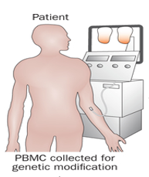
APHERESIS

Slide 8
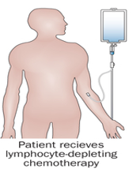
LYMPHODEPLETING CHEMOTHERAPY

Slide 9
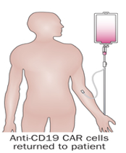
INFUSION

Slide 10
THE PROCESS
Kochenderfer, J. N., & Rosenberg, S. A. (2013). Treating B-cell cancer with T cells expressing anti-CD19 chimeric antigen receptors. Nature reviews. Clinical oncology, 10(5), 267-76.
Notes:
Prior to infusion, the patient receives lymphodepletive chemotherapy, the CART cells are infused back into the patient where they latch on to CD19

Slide 11
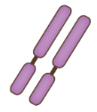
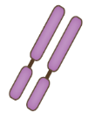
CAR-T INNOVATION
It’s a new way to target cancer cells with “CAR Modified T-Cells”
An inactivated virus is used to introduce a new receptor to the patients lymphocytes
CAR modified T-cells can now recognize and kill tumor cells
T cell
CTL019 cell
Lentiviral vector
Native TCR
Anti-CD19
CAR construct
CD19
Dead tumor cell
Tumor cell
Kochenderfer, J. N., & Rosenberg, S. A. (2013). Treating B-cell cancer with T cells expressing anti-CD19 chimeric antigen receptors. Nature reviews. Clinical oncology, 10(5), 267-76.

Slide 12
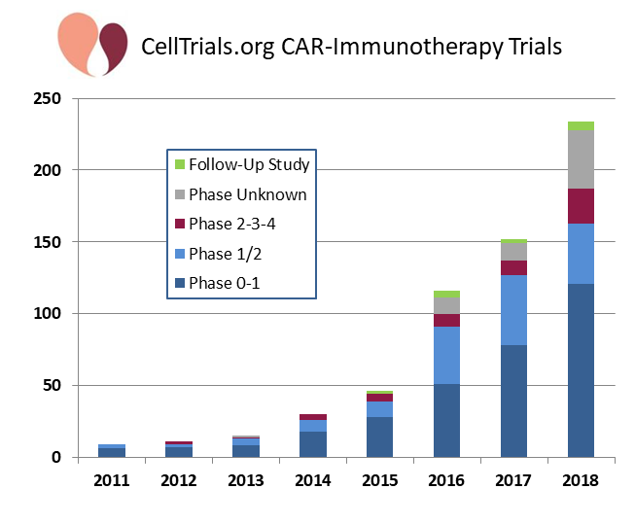
CART EVOLUTION
Schultz, L. & Mackall, C. (2019, February 27). Driving CAR T cell translation forward. Science Translational Medicine (11). doi: 10.1126/scitranslmed.aaw2127
Cell Trials Data. (2019, August 29). CAR-Immunotherapy TRIALS. Retrieved from https://celltrials.org/public-cells-data/car-immunotherapy-trials/56

Slide 13
APPROVED CAR-T THERAPIES
Axicabtagene Ciloleucel YescartaTM (KITE) | Tisagenlecleucel KymriahTM (Novartis)
FDA Approval: 10/2017 Relapsed or Refractory B-Cell Lymphoma after 2 lines of systemic therapy DLBCL NOS Primary mediastinal large B-cell High grade B-cell DLBCL arising from follicular | FDA Approval: 08/2017 Relapsed or Refractory B-Cell Lymphoma after 2 lines of systemic therapy DLBCL NOS High grade B-cell DLBCL arising from follicular CD+19 Refractory or 2nd Relapse B-Cell ALL $≤$ 25 years
*Not indicated for primary CNS lymphoma*
KymriahTM (Tisagenlecleucel) Package Insert. (2018, May). Novartis Pharmaceuticals.
YescartaTM (Axicabtagene ciloleucel). (ND). KITE Pharma.
Notes:
CAR T-cell therapy was the first FDA-approved gene therapy, marking the beginning of an entirely new approach to treating serious and even life-threatening diseases. When we look at CAR-T cell therapy, we want to know who can receive it and there are currently 2 approved therapies in the U.S

Slide 14
IMMEDIATE CAR-T TOXICITIES
Cytokine Release Syndrome (CRS)
Neurotoxicity
Notes:
We expect two major side effects with CAR-T therapy: CRS and Neurotoxicity. As we discuss these, please remember that both of these side effects are expected and treatable.

Slide 15
WHAT IS CRS?
CRS
Hypotension
Hypoxia
Renal insufficiency
Tachycardia
Chills
Fever
HLH
Cardiac arrhythmias
Neelapu, S. S., Locke, F. L., Bartlett, N. L., Lekakis, L. J., Miklos, D. B., Jacobson, C. A., …Go, W. Y. (2017, December 28). Axicabtagene Ciloleucel CAR T-Cell Therapy in Refractory Large B-Cell Lymphoma. New England Journal of Medicine, 377, 2531-2544. doi: 10.1056/NEJMoa1707447
Notes:
CRS is a supraphysiologic response following any immune therapy that results in the activation or engagement of endogenous or infused T cells . The symptoms can be progressive, and based on the new 2019 BMT consensus guidelines, it MUST include fever at the onset. Grading is then based on the presence of fever with or without both hypoxia and hypotension.

Slide 16
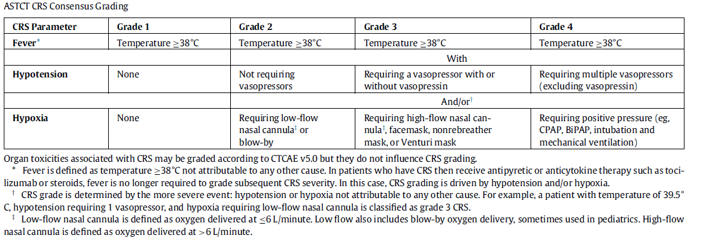
CRS GRADING AND TREATMENT
Lee, D. W., Santomasso, B. D., Locke, F. L., Ghobadi, A., Turtle, C. J., Brudno, J. N., …Neelapu, S. S. (2018, December 19). ASBMT Consensus Grading for Cytokine Release Syndrome and Neurological Toxicity Associated with Immune Effector Cells. Biology of Blood and Marrow Transplantation. doi: https://doi.org/10.1016/j.bbmt.2018.12.758
Notes:
It’s important to mention that for CRS grading, anything to the right will require ICU level care, which is not the focus of this talk
If there’s anyone from ICU, I’m happy to discuss afterwards
100.4 FYI

Slide 17
CRS COMPARISON
 | KYMRIAH (JULIET) NOVARTIS | YESCARTA (ZUMA 1) KITE
INCIDENCE | 74% | 94%
CRS ≥ GRADE 3 | 23% | 13%
MEDIAN TIME TO ONSET | 3 days (range: 1-51 days) | 2 days (range: 1-12 days)
MEDIAN DURATION | 8 days (range: 1-36 days) | 7 days (range: 2-58 days)

Slide 18
ROLE OF TOCILIZUMAB IN CRS
Grupp, S., A., Kalos, M., Barrett, D., Aplenc, R., Porter, D., L., Rheingold, S., R., … June, C., H. (2013, April 18). Chimeric Antigen Receptor-Modified T Cells for Acute Lymphoid Leukemia. New England Journal of Medicine, 368, 1509-1518. DOI: 10.1056/NEJMoa1215134
Notes:
In patients, most CD19 CAR T cell clinical trials to date have found marked inflammatory cytokine elevations in association with the onset of symptomatology and degree of severity.
Rapid clinical stabilization is frequently seen with the use of the IL-6 receptor antagonist, tocilizumab, strongly implicating cytokines, especially IL-6 in the pathophysiology of the syndrome.
Temperatures normalize often within a few hours of administering tocilizumab while the other components of CRS take longer to resolve.
No significant differences in clinical response were observed between patients who did or did not receive either tocilizumab
Outside of the cytokine response, we see significant alterations in many laboratory parameters with CRS.
C-reactive protein (CRP) is a widely available and relatively inexpensive.
CRP is not specific for CRS and our experience suggests that changes in CRP lag behind clinical changes by at least 12 hours.
While CRP is often used to follow inflammation, it is excluded from the definition and grading of CRS
Keep in mind that CRP will normalize s/p Tocilizumab therefore if you’re trending inflammatory markers, defer to others including Ferritin

Slide 19
IMMUNE EFFECTOR CELL-ASSOCIATED NEUROTOXICITY SYNDROME (ICANS)
Anxiety
Headache
Aphasia
Delirium
Insomnia
Tremor
Encephalopathy
Yale Cancer Center
Lee, D. W., Santomasso, B. D., Locke, F. L., Ghobadi, A., Turtle, C. J., Brudno, J. N., …Neelapu, S. S. (2018, December 19). ASBMT Consensus Grading for Cytokine Release Syndrome and Neurological Toxicity Associated with Immune Effector Cells. Biology of Blood and Marrow Transplantation. doi: https://doi.org/10.1016/j.bbmt.2018.12.758
Santomasso BD, Park JH, Salloum D, Riviere I, Flynn J, Mead E, et al. Clinical and Biological Correlates of Neurotoxicity Associated with CAR T-cell Therapy in Patients with B- cell Acute Lymphoblastic Leukemia. Cancer Discov. 2018;8(8):958-71.
Notes:
The earliest manifestations of are tremor, dysgraphia, mild difficulty with expressive speech especially naming objects, impaired attention, apraxia, and mild lethargy.
Headaches occur but are a non-specific symptom, frequently occurring during fever or after chemotherapy in patients without other neurologic dysfunction. Therefore, headache alone is not a useful marker of ICANS.
The median onset was 4 days
The median duration was 17 days

Slide 20
NEUROTOXICITY COMPARISON
 | KYMRIAH (JULIET) NOVARTIS | YESCARTA (ZUMA 1) KITE
INCIDENCE | 58% | 87%
ICANS ≥ GRADE 3 | 18% | 31%
Lee, D. W., Santomasso, B. D., Locke, F. L., Ghobadi, A., Turtle, C. J., Brudno, J. N., …Neelapu, S. S. (2018, December 19). ASBMT Consensus Grading for Cytokine Release Syndrome and Neurological Toxicity Associated with Immune Effector Cells. Biology of Blood and Marrow Transplantation. doi: https://doi.org/10.1016/j.bbmt.2018.12.758

Slide 21
IMMUNE EFFECTOR CELL-ASSOCIATED ENCEPHALOPATHY (ICE) SCORE
CARTOX - 10 | IMMUNE EFFECTOR CELL-ASSOCIATED ENCEPHALOPATHY (ICE) SCORE
Orientation: Orientation to year, month, city, hospital, President/Prime Minister of country of residence: (5) Naming: Name 3 objects (e.g., clock, pen, button): (3) Writing: Ability to write a standard sentence (e.g., Our national bird is the bald eagle): (1) Attention: Count backwards from 100 by ten: (1) | Orientation: Orientation to year, month, city, hospital: (4) Naming: Name 3 objects (e.g., clock, pen, button): (3) Following Commands: (e.g., Show me 2 fingers or close your eyes and stick out your tongue): (1) Writing: Ability to write a standard sentence (e.g., Our national bird is the bald eagle): (1) Attention: Count backwards from 100 by ten: (1)

Slide 22
ICANS GRADING

Slide 23
OUTPATIENT MANAGEMENT - CYTOPENIAS
Defined as:
Incomplete absolute neutrophil count (<1 x 10⁹/L)
Incomplete hemoglobin (<12 g/dL)
Incomplete platelet count (<100 x 10⁹/L)
Incidence (Recovery):
Neutropenia: 9% (11 days)
Thrombocytopenia: 65% (59.5 days)
Anemia: 72% (76 days)
Special considerations
Schaefer, Andew. Et al,. (2019, March). Cytopenias after Chimeric Antigen Receptor T-Cells (CAR-T) Infusion; Patterns and Outcomes. Biology of Blood and Marrow Transplantation. 25(3), S1717. Retrieved from https://www.bbmt.org/article/S1083-8791(18)31133-9/fulltext

Slide 24
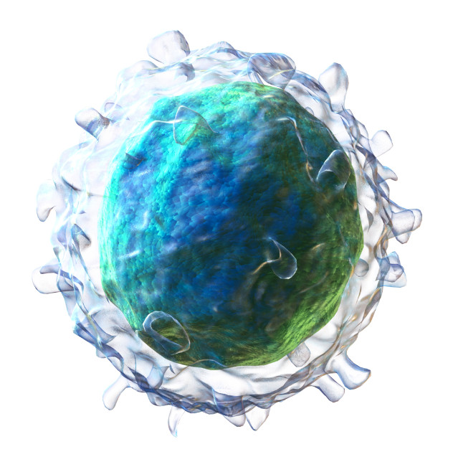
OUTPATIENT MANAGEMENT – B CELL APLASIA
CAR-T targets the antigens found on the surface of almost all B-cells therefore causing an off target effect on normal cells
Variable data
The result: decreased ability to protect against infection
The treatment: Immunoglobulin replacement

Slide 25
OUTPATIENT MANAGEMENT – SECONDARY MALIGNANCY
?

Slide 26
OUTPATIENT MANAGEMENT - RELAPSE
Initial Symptoms

Slide 27
OUTPATIENT MANAGEMENT - STEROIDS
2017-2019 general consensus: avoid high doses of steroids for long periods of time
New data: possible early use of steroids may help reduce incidence of severe CRS and ICANS without impacting responses
Topp MS, et al. Abstract 7558. Presented at: ASCO Annual Meeting; May 31-June 4, 2019; Chicago.

Slide 28
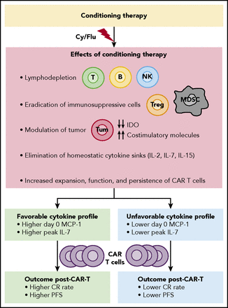
FUTURE CHALLENGES - EFFICACY
To CAR-T or Transplant?
Neelapu, S. S. (2019). CAR-T efficacy: is conditioning the key?. Blood,133(17), 1799-1800. Accessed July 18, 2019. https://doi.org/10.1182/blood-2019-03-900928.
Notes:
Efficacy: We still aren’t certain if this therapy should be used with a curative intent versus a bridge to allogeneic transplant. Prior to CAR-T, autologous stem-cell transplant was the only treatment option for patients with relapsed or refractory disease, providing a long-term survival rate of 20% (Starr, 2019). Patients are now eligible to receive CAR-T instead of transplant and have 40-60% durable response rates (Wang et al., 2019).

Slide 29
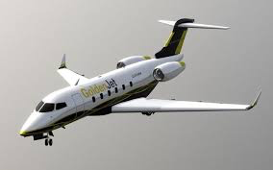
FUTURE CHALLENGE - APPLICATION
Notes:
Production: There remain multiple logistical challenges with CAR-T therapy including how the cells are produced with a concern via a 3 week turnaround. Some centers are developing their own manufacturing sites within the institute. I mean, think about the timeline for a second. We are asking these patients who are relapsed, refractory to travel to a large center who has the multi-disciplinary team to handle these toxicities, but they have to remain healthy enough for 3 weeks until collection? That’s a pretty limited patient population right there. Real world application: relapsed, refractory yet stable to travel and healthy to wait for cells
Juliet: ~30% did not receive collected cells due to patient related reasons

Slide 30
FUTURE CHALLENGE - TOXICITIES
Emergency “kill” switchers
Super Rituxan
Notes:
An emergency “kill” switch to the CAR-T cells to address the onset of CRS. Several firms are working on such solutions, including Houston-based Bellicum Pharmaceuticals, which has engineered a safety switch using two engineered proteins that dimerize when exposed to a small-molecule drug called rimiducid. Rimiducid activates a protein called caspase-9, which initiates the process of CAR-T-cell suicide.
Antibody-based safety switch to induce the suicide of CAR-T cells. The French company Cellectis tags its CAR-T cells with a protein that the cancer antibody rituximab—marketed as Rituxan - can bind. A rituximab injection should cause a patient’s normal immune cells to target and kill the CAR-T cells. Cellectis is working on new versions of CAR-T cells that can be activated or deactivated with small molecules.

Slide 31
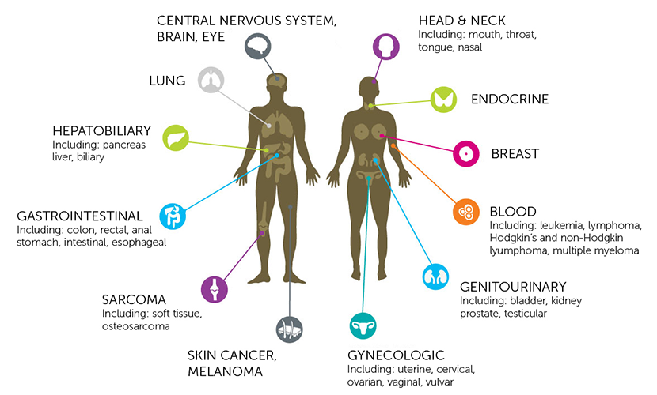
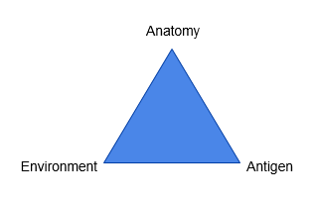
FUTURE CHALLENGE – SOLID TUMORS
Notes:
Each of these challenges leads to a further discussion of why do solid tumors fail
(1) CAR-T cells face difficulty gaining access to target cells sitting within poorly vascularized tumor masses, walled-off to a certain degree by nonmalignant inflammatory cells and connective tissues.
(2) On gaining access, infused CAR-T cells then face a hostile, hypoxic, and anti-inflammatory tumor microenvironment, vastly attenuating their potential cytotoxicity.
(3) For those CAR-T cells that do manage to penetrate a solid tumor and retain cytotoxic potential, there is a further fundamental issue, a lack of ideal single-antigen targets

Slide 32
IDEAL SOLID TUMOR CAR-T
Target antigen → Development of CAR T-cell construct against that antigen
Decreased immunosuppressive nature of the tumor microenvironment
Increased persistence after infusion of cells

Slide 33
SARCOMA RESPONSES
Sarcomas: HER2
10 patients aged 4-54 (pediatric and adult)
Inclusion: Refractory or metastatic HER2 positive sarcoma
Design: Received up to 3 infusions with HER2 CART cells + lymphodepletive chemotherapy (fludarabine +/- cyclophosphamide)
Results: 2 CR, 3 stable disease, 5 progression
CR: 2 (17 and 32 months)
Significance
Cavallo, Jo. (2019, April 1). AACR 2019: HER2-Targeted CAR T-Cell Therapy Plus Chemotherapy in Advanced Sarcoma. The ASCO Post. Retrieved from https://www.ascopost.com/News/59888
Notes:
HER2:
Inclusion: (5 osteosarcoma, 3 rhabdomyosarcoma, and 1 Ewing sarcoma). Patients had 5 previous therapies.
Of those who had a CR, both were pediatric patients who at 17 and 32 months had DFS
Why is this important?: Although clinical studies have shown that HER2-targeted antibodies such as trastuzumab are not effective for patients with HER2-positive sarcoma, HER2-specific CAR T cells appear to have antitumor activity in these patients.

Slide 34
GLIOBLASTOMAS
Stephen J Bagley, Arati S Desai, Gerald P Linette, Carl H June, Donald M O’Rourke, CAR T-cell therapy for glioblastoma: recent clinical advances and future challenges, Neuro-Oncology, Volume 20, Issue 11, November 2018, Pages 1429–1438, https://doi.org/10.1093/neuonc/noy032
Notes:
For glioblastomas, they used CAR-T cells via local intracranial infusions for recurrent glioblastomas and they had regression of all intracranial and spinal tumors for 7.5 months

Slide 35
CAR-T IN MULTIPLE MYELOMA
Not yet FDA approved, but studies are promising
Multiple studies looking at different CAR constructs
bb2121 is a CAR that targets B-cell maturation antigen (BCMA)
Multicenter Phase 1 study with R/R MM received bb2121in either a single infusion in dose escalation cohort or expansion cohort
Median age was 60 (range 37-75)
Measurable disease
At least 3 previous lines of therapy
Early data reported in NEJM on the first 33 patients
Objective response rate was 85%
CR seen 45% (15 patients)
However 6 of the 15 in CR have relapsed
Median PFS was 11.8 months

Slide 36
CURRENT TRIALS

Slide 37
FUTURE OF CAR-T
Expanding CAR 19 to Other Heme Malignancies
CLL
Additional lymphoma subtypes (MCL, FL)
Using CAR-T earlier in DLBCL
First line treatment in high grade lymphoma
Timing of transplant vs CAR-T
Improve the CARs Efficiency
Combination treatment (immune checkpoint inhibitors, imids, TKIs, 41BB agonist)
Further CAR engineering (PD-1 knockout CAR)

Slide 38
IDEAL CAR
Notes:
With so many parallel developments advancing CAR-T technology, it will take some time to unpick the ideal methods to optimize both efficacy and safety. The “ideal CAR” will, of course, continue to change as our progress in this area continues, and we learn more about the subtleties of the technologies we have already developed.

Slide 39
QUESTIONS
?

