Slide 1
Leading with Purpose & INNOVATION: How Beating the Odds Through Progressive Thinking Paved the Way for my Future
Maggie A. Smith ,DNP, MSN/Ed, RN, OCN©
Notes:
Every story has a beginning, middle and end; however the story that I will share with you today will have a beginning, a middle but it will not have an end. You see the world is shaped by two things the stories people tell and the memories they leave behind and God willing, I still have many more memories to make and share so that I can leave them behind..

Slide 2
OBJECTIVES Leading with a Purpose
Define leadership
Identify a “ boss vs. leader”
Developing your leadership legacy
Define transformational leadership
Review types of transformational leaders
Identify stakeholders in transformational leadership
Identify traits and characteristics of a transformational leader
Discuss personal beginnings
Describe how to be innovative as a leader

Slide 3
IN ORDER TO LEAD YOU MUST…
Notes:
Leadership development is vital because organizations take on the personality of their leaders.
Leadership is all about being passionate about what you do, and having confidence in yourself and your followers.
We plant trees because they help to reduce ozone levels, leaders help to reduce stressful situations. Trees sequester carbon, helping to remove carbon dioxide and other greenhouse gases from the air, which cools the earth, just as leaders help to remove negativity, and Debbie Downers from the workplace or minimize their presence. We need leaders because they are vital to the success of their people and the organization.

Slide 4
WHAT IS LEADERSHIP? Leading with a Purpose
“Leadership is seen in terms of unifying people around values and then constructing the social world for others around those values and helping people to get through change (Stanley 2009).”
Being a leader implies that you are a person with a vision, who can bring people together, determine and respect others values, facilitate – and can emphasize the focus for change that we encounter in practice.
Leadership is about helping others to succeed…

Slide 5
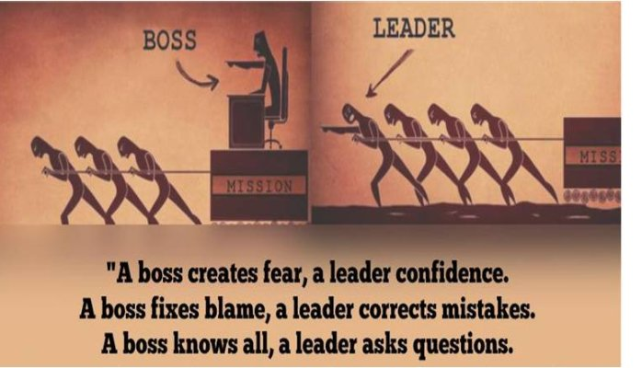
BOSS vs. LEADER
Notes:
We use these terms interchangeably when in fact they are not, for the record they are completely opposite. Leadership—it is a word we use often, but are rarely able to describe so let me highlight the differences between these two terms for you.

Slide 6
WHY LEAD?
Patient Advocacy – Patient Satisfaction
Influence others to bring a vision of excellent patient care to reality.
Lead change where challenges/failures persist
Improve processes for efficiency in workflow/staffing

Slide 7
MOTIVATION TO LEAD
Intrinsic desire to:
Build a team that provides excellent clinical, compassionate care for oncology patients and families.
Visionary:
Developing a comprehensive cancer center with a holistic and collaborative approach
Providing compassionate patient care with excellent customer service.
Seamless workflows for patient care – patients unaware of efforts.

Slide 8
LEADERS ARE IRREPLACABLE
Successful leaders initiate actions and welcome change.
They:
are proactive and not reactive (risk takers)
reach out to people, ask questions, make suggestions and offer assistance
influence
are visible
DON’T BE THE TYPE OF LEADER:
Always reactive
Who does not take a risk and plays it safe

Slide 9
THE ORIGINATION OF A LEADER
Are leaders born or made?
BOTH. Evidence that both inherent personality and environment are factors.
What type of leader will you be? What will the next generation of nurses say about you?
Notes:
There is a lot of debate about this topic; however what the literature shows are both. Leadership capability falls along a bell curve and at the top of the curve you have about 10% of leaders who were born to lead, these leaders tend to get better as time progresses, then you have about 10-15% at the bottom of the curve and no matter how hard they try will never be a good leader. Lastly in the middle sits the majority of individuals who possess the traits and potential to become a good leader, their talents are just waiting to be nurtured into great leaders.

Slide 10
INTRODUCTION TO TRANSFORMATIONAL LEADERS
Following is a video outlining what it means to be a transformational leader retrieved from YouTube® on Transformational Leaders:
https://www.youtube.com/watch?list=PLaUTGH_7gNSIKeYgl5dYYLCT14-3KfbSD&v=jsjlJCOzmhk
Notes:
Transformational leaders can be misunderstood, and they are sometimes disliked by the very people they are called to serve. The reason for this is because transformation requires change, the element of life that we usually try to avoid.

Slide 11
WHAT IS TRANSFORMATIONAL LEADERSHIP?
According to Avolio, Walumbwa and Weber (2009), transformational leadership is defined as:
“Leader behaviors that transform and inspire followers to perform beyond expectations while transcending self-interest for the good of the organization.”
Notes:
American Nursing Credentialing Center Magnet Recognition Program places emphasis on the CNO as a transformational leader. The CNO is the one who develops a strong vision and philosophy , effectively communicates expectations, develops others and leads the organization to meet strategic priorities.
Transformational leadership is seen as the core component of the Magnet Model, in conjunction with exemplary professional proaction, innovation, structural empowerment, new knowledge and empirical outcomes.

Slide 12
TYPES OF TRANSFORMATIONAL LEADERSHIP
There are FOUR types of transformational leadership:
Charisma- arouses strong follower emotions and leader identification
Intellectual stimulation-increases follower awareness of problems and influences followers to view problems from a new perspective
Inspirational motivation-communicates an appealing vision, using symbols to focus subordinate effort and model appropriate behaviors.
Individualized consideration-provides support, encouragement, and coaching to followers
Notes:
Charisma words spoken by John Travolta about Oprah, her giving back to people
Intellectual stimulation open the school in Africa
Inspirational motivation: the woman who was inspired by standing in her shoes
Individualized consideration mentorship with Dr. Oz, Rachel Ray Dr. Phil

Slide 13
STAKEHOLDERS INVOLVED IN TRANSFORMATIONAL LEADERSHIP
The leaders
Accepts responsibility for actions and results of the group
Place responsibility of the employee, organization and clients above self
Serves as a model of behavior
The employees
Wants a capable leader that they can respect and admire
Decent working conditions
Fair treatment and job security
Wants knowledge of the results of their efforts
The patients
Wants compassionate and knowledgeable healthcare providers

Slide 14
CHARACTERISTICS AND TRAITS OF TRANSFORMATIONAL LEADERS
Encourage creativity and ideas
Develop shared governance
Transformational leaders can unlock boundaries and promote self-reliance among their followers/staff.
Listen, they praise
Increase awareness
Energize you staff!
Assign people to different tasks; people have a sense of importance and purpose when they feel valued.
Involve staff in activities such as policy creation or training development.

Slide 15
HOW TRANSFORMATIONAL LEADERS INFLUENCE Leading with a Purpose
Transformational leaders influence their followers’ perceptions of what is important.
Promote idealization of influence or instilling employee pride in their vision or mission
Utilize idealized or behavioral influence or using leader behaviors to demonstrate their values
Inspire staff by increasing their awareness
Influence staff to think in new ways
Express appreciation when the mission is accomplished

Slide 16
WHO ARE TRANSFORMATIONAL LEADERS?
Notes:
Transformational leadership has been applied to both healthcare and patients. A few key issues that have been addressed utilizing this style of leadership:
Nurse satisfaction
Nurse retention
Diversity
Patient safety
Work engagement
Quality outcomes

Slide 17
WORDS TO LIVE BY….
“ We don’t need a title to lead. We just need to care. People will follow a leader with a heart faster than a leader with a title.”
-Craig Groeschel

Slide 18
WHERE IT ALL BEGAN FOR ME.. Leading with a Purpose

Slide 19
WHEN MY LIFE CHANGED How I Beat the Odds

Slide 20
WHO AM I? Leading with a Purpose
Humanitarian
Sister
Daughter
Advocate
Godmother
Entrepreneur
Transformational

Slide 21
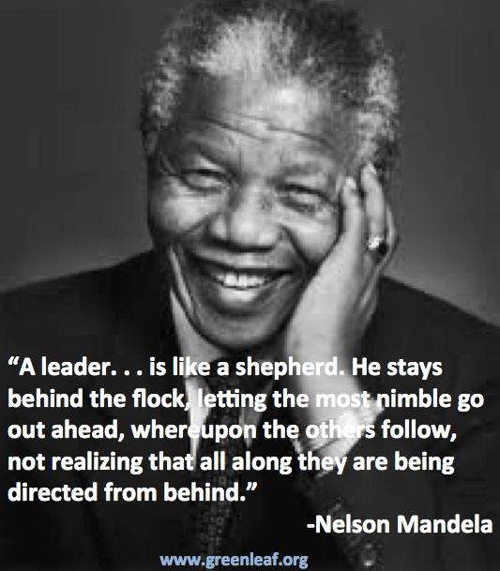
Notes:
Dr. Martin Luther King, Jr. continues to be the epitome of leadership, evoking words such as these that are influential and can still resonate with individuals today.
It’s not just one thing that makes a leader: it’s a combination of traits that all complement each other.

Slide 22
HOW I AM CREATING MY LEADERSHIP LEGACY How I Beat the Odds
Develop and communicate a vision that is clear and a win-win for all; true leaders create more leaders and not followers!

Slide 23
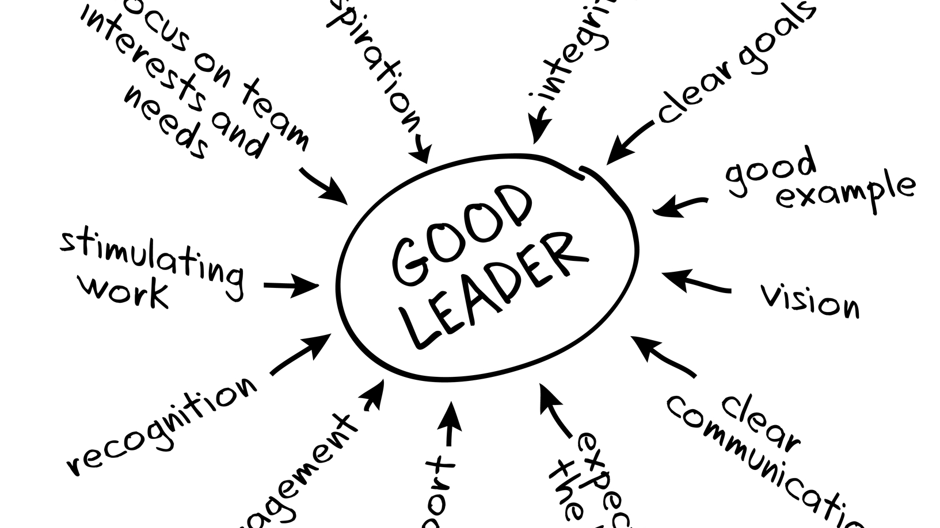
MY TIME AS A CLINICIAN Leading with a Purpose: CHARISMA

Slide 24
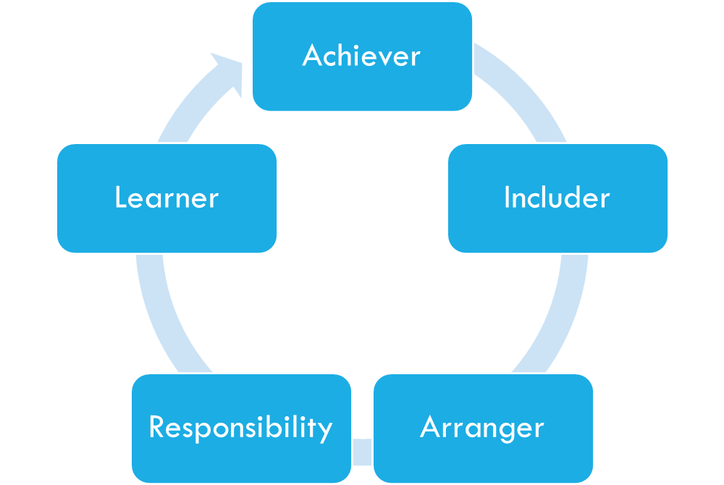
MY LEADERSHIP STRENGTHENS StrengthS Finder Assessment: Top Five Strengthens
Notes:
The basic philosophy behind StrengthsFinder is that everyone has natural talents and that we’ll get the farthest in life if we focus on elevating our personal strengths, rather than trying to balance out our weaknesses. More like a validation of who you are, it’s excellent for teams and It provides tons of suggestions for using your strengths in your life and business.

Slide 25
MY LEADERSHIP APPOINTMENTS Leading with a Purpose: Intellectual Stimulation
Notes:
Great leaders make the hard choice, and self-sacrifice in order to enhance the lives of others around them.

Slide 26
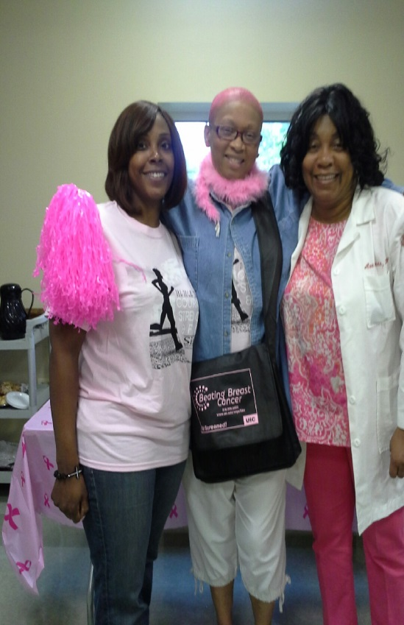
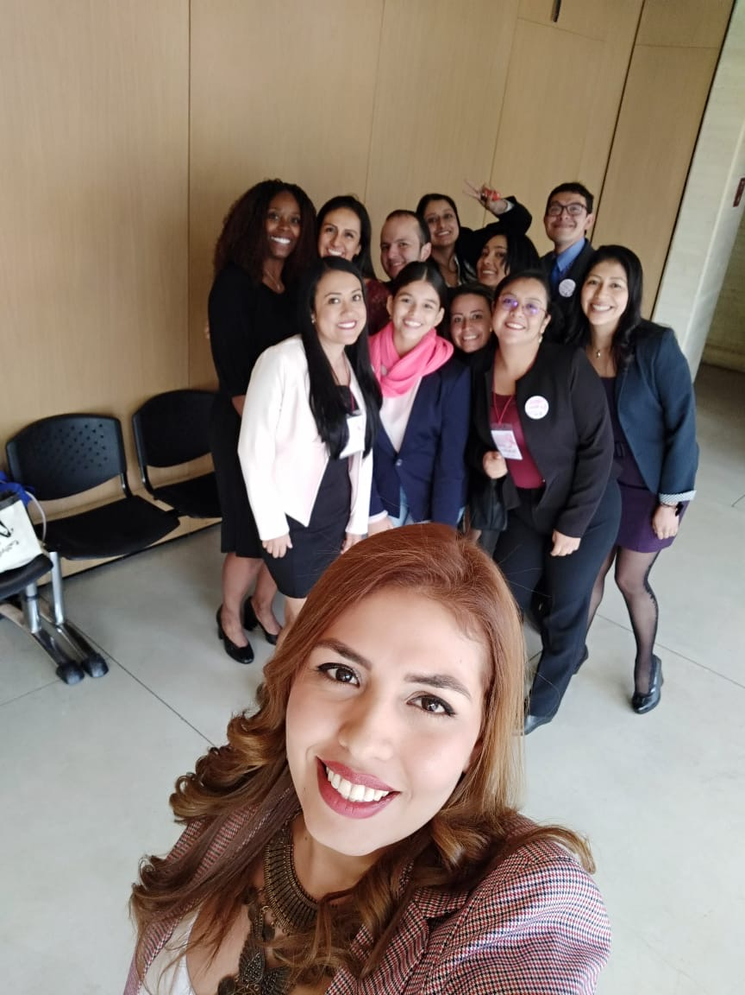
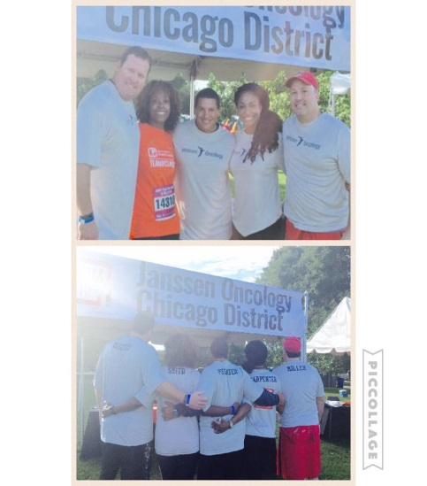
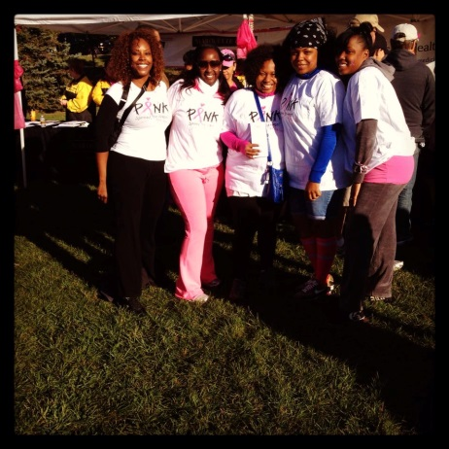
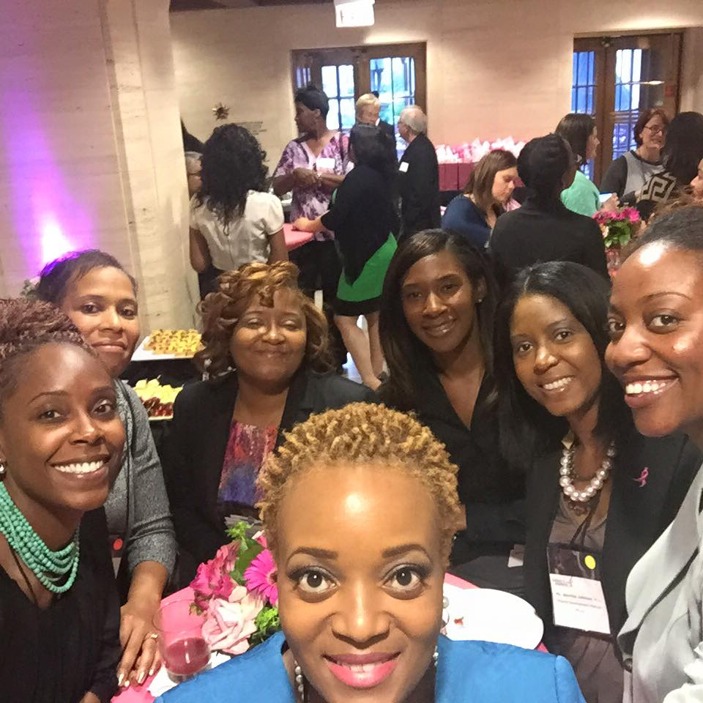
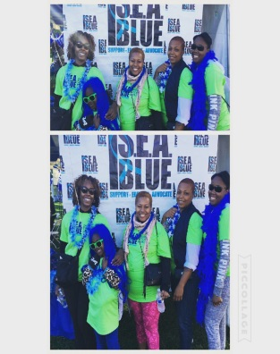
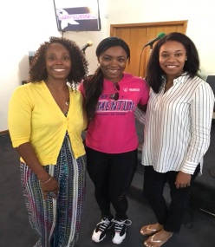
MY TIME IN THE COMMUNITY Leading with a Purpose: Inspirational Motivation

Slide 27
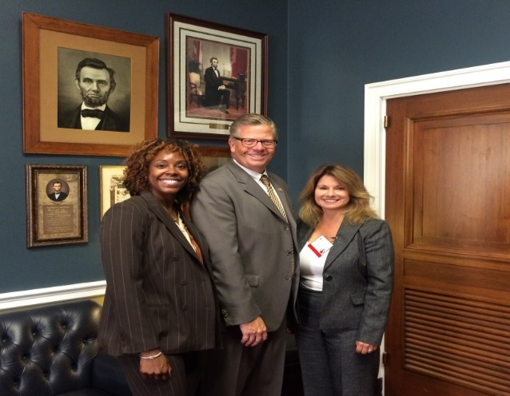
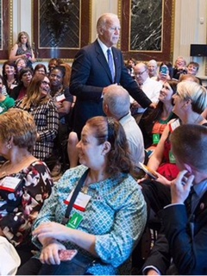
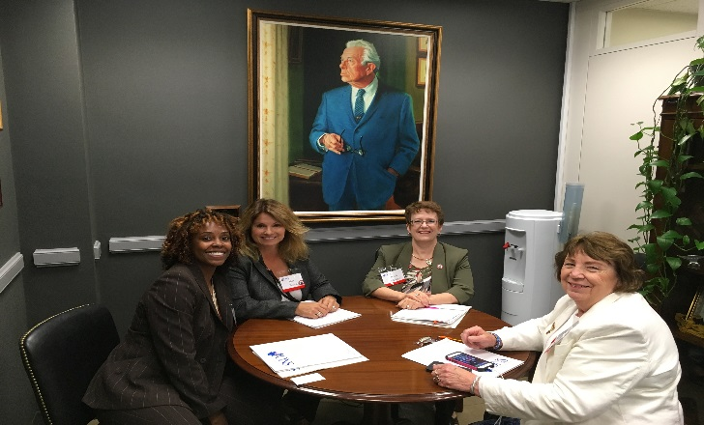
MY TIME ON THE HILL Leading with a Purpose: Inspirational Motivation

Slide 28
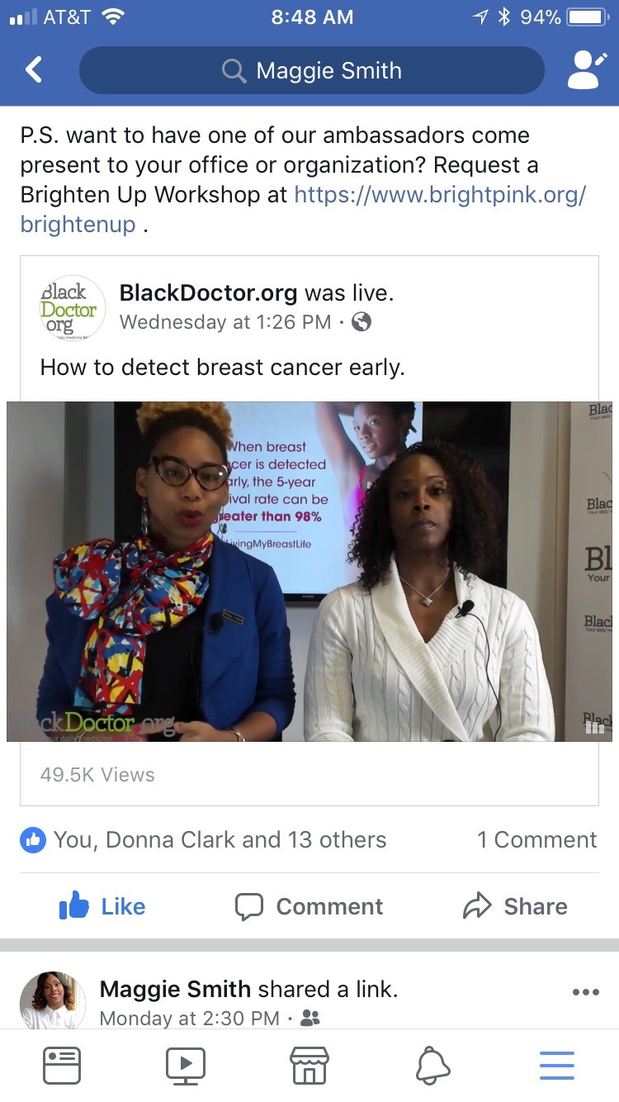
MY RESEARCH/CLINICAL INTEREST Leading with a Purpose: Individualized Consideration
Smith, M., Conway-Phillips R, Francois-Blue T. 2016. Sisters Saving Lives: Instituting a Protocol to Address Breast Cancer Disparities.; Clinical Journal of Oncology Nursing 20(4):427-432. PMID: 27441516 [PubMed - as supplied by publisher]

Slide 29
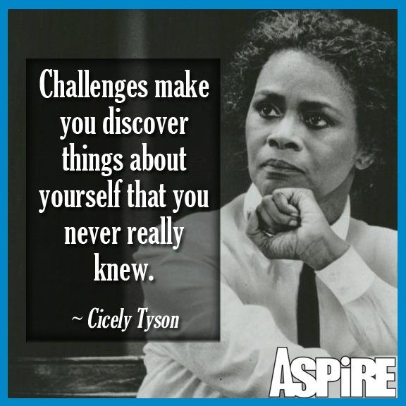
INSPIRING INNOVATION AS A LEADER
Act with urgency
Being visible
Model healthy work habits
Virtual Technology
Communicate with transparency
Helps others feel secure
The unique demands of the moment
Balance empathy and authenticity
Let go of your ego and listen to others while also being assertive about what you value
Look Ahead
Thinking and planning for the longer term even as you put out the fires raging around you
Reset priorities

Slide 30
IMPORTANCE OF REINVENTING & REINVIGORATING YOURSELF
Balance and self-care
Agility, humility and resiliency
Be curious and forward thinking with the ability to effectively drive organizational change and continuous learning and innovation.
Be comfortable challenging the status quo and bring forward innovative solutions.
Ability to articulate, influence and implement business solutions based on trends, needs and opportunities within the US healthcare environment.
NEVER STOP DREAMING!

Slide 31
FINAL THOUGHTS…
“Those who died yesterday had plans for this morning. And those who died this morning had plans for tonight. Don’t take life for granted.”
-Robert Mugabe
TODAY & EVERYDAY DETERMINES YOUR LEGACY SO MAKE EVERYDAY GREAT!
Maggie Smith

Slide 33
REFERENCES Leading with a Purpose
Avolio, B., Walumbwa, F., Weber, T., (2009). Leadership: Current theories, research and future directions. Annual Review of Psychology. Volume 60 pgs 421-49.
Management study guide (2017). Retrieved October 21, 2017 from, http://www.managementstudyguide.com/transformational-leadership.htm
McConnell, C. (2003). Accepting leadership responsibility. Preparing yourself to lead honestly, humanely and effectively. The Health Care Manager. 22(4). Pgs. 361-374
Nikolaos, C., Tsaloukidis, T., Dimitrios O., Dimitrios E. Christina, M.,, Maria, P.,. (2012). Head nurse perceptions of their managerial leadership behaviours: a pilot study. Health Science Journal. Volume 6, Issue 2.
Richardson, D. (2011). Transformational leaders. Radiologic technology. May/June Vol. 82/No. 5.

Slide 34
REFERENCES CONTINUED Leading with a Purpose
Stanley, S., (2009) Clinical leadership and the theory of congruent leadership In: Bishop V (2009) (ed) Leadership for Nursing and Allied Health Care Professionals. McGraw Hill, Berkshire.
Yang, Feng-Hua; Wu, Melien; Chang, Chen-Chieh; Chien, Yuhsin (2011). Elucidating the relationships among transformational leadership, job satisfaction, commitment foci and commitment bases in the public sector. Public Personnel Management, 40 (3): 265-78
YouTube®. (2020). Retrieved September 23, 2020 from, https://www.youtube.com/watch?list=PLaUTGH_7gNSIKeYgl5dYYLCT14-3KfbSD&v=jsjlJCOzmhk

