Slide 1
Updates on the Utilization of Immune Checkpoint Therapy: Considerations for the Management of Toxicities.
2019 Annual Oncology Nursing Symposium
SWCONS-CCONS November 2, 2019
Marianne Davies, DNP, CNS-BC, ACNP-BC, AOCNP-BC
Associate Professor, Yale University School of Nursing
Thoracic Oncology Nurse Practitioner, Smilow Caner Hospital

Slide 2
Disclosures-Speakers Bureaus: AstraZeneca, Bristol Myers Squibb, Genentech, Merck

Slide 3
Approved & Emerging Checkpoint Inhibitors
Drug & Target | DOSE | INDICATIONS (Line of treatment varies by disease)
Ipilimumab Anti CTLA-4 | Met Mel: 1-3 mg/kg IV over 90 min, every 3 weeks x 4 Adj Mel: 10 mg/kg/IV every 3 weeks x 4, then 10 mg/kg every 12 weeks up to 3 years. | Melanoma: adults & pediatrics, unresectable, metastatic; adjuvant; Renal Cell (intermed/poor risk)-in Combo with Nivolumab MSI-H or dMMR metastatic CRC >12 yrs
Tremelimumab Anti CTLA-4 | Orphan Drug Destination | Mesothelioma
Nivolumab Anti-PD-1 | 240 mg IV over 60 min, Q2 weeks | Melanoma, Renal Cell, NSCLC, SCLC, Hodgkin Lymphoma, SCCH&N, Urothelial, Microsatellite Instability-high or mismatch repair deficient solid tumor, Hepatocellular
 | 480 mg IV over 60 min, Q 4 weeks
 | Combination with ipilimumab | Melanoma; MSI-H/dMMR-CRC
Pembrolizumab Anti-PD-1 | 200 mg IV over 30 min, Q 3 weeks | Melanoma, NSCLC *, SCLC, SCCH&N, Hodgkin's Lymphoma, B-cell lymphoma, Urothelial, Microsatellite instability or mismatch repair deficient solid tumor, Colorectal, Gastric, Esophageal, Cervical, Hepatocellular, Merkel Cell, Renal Cell, Endometrial *Considerations for PD-L1 testing
 | 200 mg IV in combination with chemotherapy Q3 weeks | NSCLC; SCCH&N
Atezolizumab Anti-PD-L1 | 1200 mg IV over 60/30 min, Q 3 weeks | NSCLC, SCLC, Triple Negative Breast Cancer (all in combination with chemotherapy)
 | 840 mg Q2 wks; 1200 mg Q 3 wks; 1680 mg Q4 wks | NSCLC, Urothelial
Durvalumab Anti-PD-L1 | 10 mg/kd IV over 60 min, Q2 weeks | Urothelial; Stage III NSCLCL adjuvant
Avelumab Anti-PD-L1 | 10 mg/kg IV over 60 min, Q 2 weeks | Merkel cell; Urothelial

Slide 4
Cancer Immune Cycle
Chen & Mellman (2013).Immunity. 39.

Slide 5
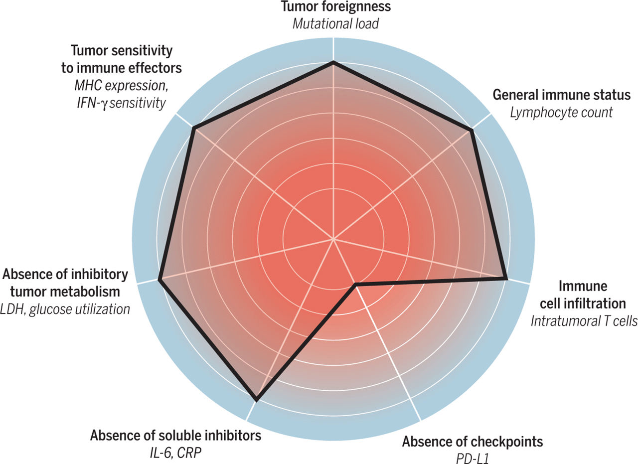
The cancer immunogram.
Christian U. Blank et al. Science 2016;352:658-660
Copyright © 2016, American Association for the Advancement of Science

Slide 6
Immune Related Adverse Events (IRAEs)
Common AEs

Slide 7
PATTERNS OF IRAEs
Onset
Median onset is 5-12 weeks after initiation
Within days of first dose
After months of treatment
After discontinuation of therapy
Severity
Incidence/severity higher in anti-CTLA-4 agents
High grade AE to one does not preclude safe administration to another class
Davies, M. & Duffield, E. (2017). Safety of checkpoint inhibitors for cancer treatment: strategies for patient monitoring and management of immune-mediated adverse events. ImmunoTargets and Therapy. 6:51-71
Puzanov et al. 2017. JITC

Slide 8
ICPI vs Chemotherapy
Lower total AEs* (67.6% vs 82.9%)
Lower high-grade AEs* (11.4% vs 35.7%)
Lower treatment discontinuation* (4.5% vs 11.1%)
Lower treatment-related deaths (0.6% vs 1.4%)
*Statistically Significant
Nishijima et al 2017 The Oncologist

Slide 9
Fatal irAEs
Chemotherapy Fatalities: 1.4%
ICB Fatality rates vary
PD-1/L1 = 0.25 to 1.1%
CTLA-4 = 0.2 to 1.1%
PD-1/L1 + CTLA-4 = 0.28 to 1.23%
Onset is relatively quick
40 days after starting monotherapy
14.5 days with PD-1 + CTLA-4
Wang et al. 2018. JAMA Oncol.
Nishijima et al. 2017. The Oncologist

Slide 10
Possible Mechanisms of Immune Related Adverse Events
ICPIs promote T-cell activity against antigens present in tumors and healthy tissue
Activation of the immune system cannot be confined to antitumor effects
Amplification of immune system can lead to unrestrained T-cells attack on healthy tissue: “auto-immunity”
Increased levels of preexisting autoantibodies or promotion of de novo antibodies
Increased levels of inflammatory cytokines
Other
Genetics: HLA type, polymorphisms
Environmental: Gut flora
MA Postow et al. 2018. NEJM.
Sury et al. 2018. Nat Rev Nephrol.
Soularue et al. 2018. Gut.
Michot et al. 2016. Europ J Cancer

Slide 11
Algorithm for Management of IRAEs Questions: Continue ICPI, Suspend, Discontinue Use of Steroids & Referral to specialists
GRADE | Assessment & Management
Grade 1 | Asymptomatic; Diagnostic Changes only; Continue Immunotherapy
Grade 2 | Mild to moderate symptoms. Grade 2 diagnostic abnormalities Hold Treatment. Provide supportive care Methylprednisolone 0.5-1.0 mg/kg/day until stable (or oral equivalent)
 | If improving: Transition to oral steroid at start of taper Dose suggested: 60 mg prednisone daily x 2 weeks Taper over 4 weeks or more to reduce recurrence of symptoms May consider re-initiation of immunotherapy
 | If progressing: Treat as grade 3-4 Consider hospitalization of patient. Multidisciplinary evaluation of toxicity
Grade 3 to 4 | Discontinue immunotherapy (consider organ specific algorithms-endocrine) Hospitalization indicated Methylprednisolone 1.0-2.0 mg/kg/day until stable
Refractory | If no improvement or progression, additional immunosuppressant treatment may be needed -Infliximab 5 mg/kg (except if contraindicated0 -Mycophenolate mofetil 1 gram twice daily -Cyclosporine or intravenous immunoglobulin (IVIG)

Slide 12
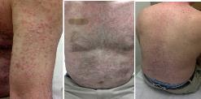
Dermatologic Toxicities: Maculopapular Rash
Prevent/Anticipate | Detect/Monitor
Macule, papule, morbilliform rash; pruritis; Eczema, psoriasis; eosinophilic infiltrates, lichenoid deposits. Alopecia; Vitiligo (correlates with +outcome) Consider all mucous membranes | Rule out other causes: -Cellulitis, Contact dermatitis, other drug reactions, allergies, sun exposure, radiation recall Total Body Exam, including mucosa; Measure distribution Assess impact on ADLs Assess for prior inflammatory dermatologic processes
Treatment/Management General: Supportive care; Sun Protection, screen, sunglasses Consider biopsy if unusual features
Mild G1 <10% BSA | Moderate Grade 2 10-30% BSA | Severe Grade 3-4 >30% BSA
Continue immunotherapy Treat with moderate potency topical steroids Oral antihistamines Topical emollients | Consider holding immunotherapy Treat with high potency topical steroids and/or prednisone 0.5-1.0 mg/kg/day Oral antihistamines Topical emollients | Hold immunotherapy Treat with high potency topical steroids Prednisone 0.5-1.0 mg/m2/day (increase up to 2.0 mg/m2/day, if not responsive) Urgent dermatologic consult

Slide 13
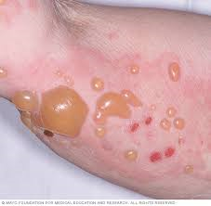
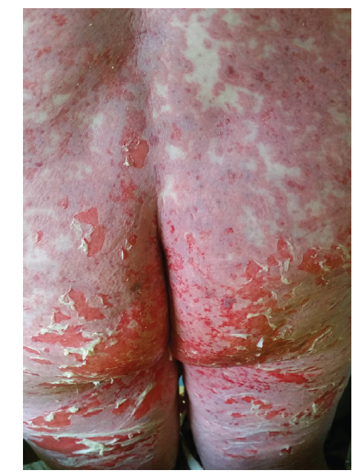
Dermatologic Toxicities
Prevent/Anticipate |  | Detect/Monitor
DRESS/ DIHR |  | Rule out other causes: -Cellulitis, Contact dermatitis, other drug reactions, allergies Total Body Exam, including mucosa; Measure distribution Assess impact on ADLs Assess for prior inflammatory dermatologic processes
Treatment/Management Urgent Dermatologic Consultation
Bullous Dermatitis |  |  | Steven Johnsons Syndrome Toxic epidermal necrolysis
Mild G1 <10% BSA | Moderate Grade 2 10-30% BSA | Moderate Grade 2 | Severe Grade 3 >30% BSA | Life Threatening Grade 4
Hold immunotherapy High potency topical steroids | Hold immunotherapy Prednisone 0.5-1.0 mg/kg/day Oral antihistamines Topical emollients | Consider holding immunotherapy Treat with high potency topical steroids and/or prednisone 0.5-1.0 mg/kg/day Oral antihistamines Topical emollients | Permanently discontinue Prednisone 0.5-1.0 mg/m2/day (increase up to 2.0 mg/m2/day, if not responsive) Inpatient care: ICU or burn Unit Urgent dermatologic and ophthalmology consults | Permanently discontinue Prednisone 1.0-2.0 mg/m2/day Inpatient care: ICU or burn unit Urgent dermatologic and ophthalmology consults

Slide 14
Gastrointestinal Toxicities
Prevent/Anticipate | Detect/Monitor
Educate patients Onset 3 days to 10 weeks, or months Avoid foods that cause loose stools *Consider opioid constipation Diarrhea more common with dual ICPI; earlier with anti-CTLA-4 Risk: perforation & sepsis | Calculate frequency and volume of diarrhea in 24 hours (including ostomy; incontinence). Monitor for mucous or blood in stool. Abdominal CT scan with contrast Mesenteric engorgement Bowel wall thickening Fluid-filled colonic distention Stool evaluation to rule out infectious etiology: -Nucleic acid amplification tests (NAATS) for GI pathohgens/bacterial culture -C. difficile -Ova & parasite: molecular test for Giardia and Crypzosporidium app and E. histolytica, Consider microsporidia Cyclosporal/isospora spp. -Viral pathogens testing when available.
Treatment/Management Supportive care; Hydration; Educate about dietary changes. GI consultation: Consider colonoscopy and EGD
Grade 1 < 4 stools >baseline | Grade 2 4-6 stools > baseline | Grade 3-4 > 6 stools > base
Consider holding Anti-spasmotic Anti-diarrheal: loperamide, diphenoxylate/atropine | Hold Immunotherapy Prednisone 1-2 mg/m2/day, if no response in 2-3 days, increase 2-4 mg/m2/day Consider infliximab If infliximab resistant, consider vedolizumide | G3: discontinue CTLA-4; consider restarting anti-PD-1/L1 if resolved G4: permanently discontinue Consider inpatient care Prednisone 2-4 mg/m2/day If no response in 2-3 days, Consider infliximab

Slide 15
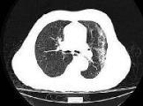
Pulmonary Toxicities
Prevent/Anticipate | Detect/Monitor
Prevention: smoking cessation, vaccinations Dyspnea, dry cough, wheezing, tachypnea, tachycardia, hypoxia, Increased oxygen requirements, Chest pain. | Rule out other causes: infection, disease progression, pulmonary embolism, pleural effusion, sarcoidosis, pulmonary fibrosis Pulmonary Function Tests.
Treatment/ Management Supportive care; Dyspnea management; Oxygen support; Nebulizer Treatment
Grade 1: < 25 % lung | Grade 2: 25-50% lung | Grade 3-4
Hold immunotherapy Reassess in 1-2 weeks Pulse oximetry rest and ambulation Consider chest imaging with CT (with contrast preferred) Repeat in 3-4 weeks. | Hold immunotherapy Infectious workup nasal swab, sputum, blood Consider bronchoscopy and BAL Chest imaging with CT contrast Repeat in 3-4 weeks Consider empiric antibiotics Methylprednisolone 1-2 mg/m2/day; If no response in 3-4 days, treat as grade 3 | Permanent discontinue immunotherapy Inpatient care Infectious work up Pulmonary & infectious disease consultation Bronchoscopy with BAL Empiric antibiotics Methylprednisolone 1-2 mg/m2/day; when grade 1, taper over 6 weeks. If refractory, infliximab, mycophenolate or IVIG

Slide 16
Endocrine Toxicities
Prevent/Anticipate | Detect/Monitor | Detect/Monitor
Baseline laboratory assessment Fatigue, sluggishness, anorexia, weight loss/gain, irritability, palpitations, feeling hot/cold, visual disturbances, headaches, change in sexual drive. | Close laboratory monitoring Monitor TSH & free T4 every 4-6 weeks. | Close laboratory monitoring Monitor TSH & free T4 every 4-6 weeks.
Treatment: Thyroid Dysfunction Levothyroxine: adjust levels to maintain free T4 level at mid-range Typically: 1.6 mcg/kg/day Educate patients that hormone replacement in likely lifetime
Asymptomatic Hypothyroidism | Clinical Hypothyroidism |  | Thyrotoxicosis
TSH btw 4-10; T4 norm: continue ICPI TSH >10; T4 norm: continue; consider levothyroxine TSH low; T4 low/norm: consider central hypothyroidism | Monitor TSH and T4 every 4-6 weeks Levothyroxine replacement Consider endocrine consultation Exclude concomitant adrenal insufficiency |  | Continue ICPI Propranolol for palpitations Repeat TFTs in 4-6 weeks.

Slide 17
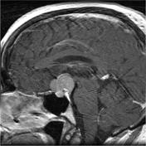
Endocrine Toxicities
Prevent/Anticipate | Detect/Monitor
Baseline laboratory assessment Fatigue, sluggishness, anorexia, weight loss/gain, irritability, palpitations, feeling hot/cold, visual disturbances, headaches, change in sexual drive. | Close laboratory monitoring with: ACTH, am cortisol, FSH, LH, renin, TFTs, estradiol, testosterone, comprehensive metabolic panel Monitor TSH & free T4 every 4-6 weeks.
Treatment: Adrenal and Pituitary Dysfunction Treatment: patient education about stress dosing for hormones. Alert bracelet
Adrenal Insufficiency | Hypophysitis
Endocrine consultation HOLD immunotherapy Start corticosteroids before other hormone replacement to prevent adrenal crisis Steroid replacement Hydrocortisone 20 mg am, 10 mg pm, slowly titrate down according to symptoms Or Prednisone 7.5 mg or 10 mg and titrate AND Fludrocortisone 0.1 mg QOD, then titrate to BP May need additional fluids if hypotensive | MRI of brain with pituitary cuts (sellar cuts) HOLD immunotherapy Methylprednisolone 1-2 mg/m2/day Hormone replacement as necessary

Slide 18
Presentation & Management of IrAEs
System | Signs & Symptoms | Evaluation | Additional Management
Hepatic | Nausea, vague abdominal discomfort, RUQ pain, dehydration, jaundice, bleeding, bruising, dark skin, drowsiness. | Liver enzymes (AST, ALT, ALK, total and direct bilirubin; Liver ultrasound, GI consult r/o viral syndrome | Hold hepatotoxic drugs Mycophenolate 2 mg/kg/d, if refractory NO Infliximab
Renal, Nephritis | Elevated serum creatinine, vague nausea, emesis; Decreased urine output; Blood in urine, Ankle swelling | Serum creatinine, urinalysis; Nephrology consult; Renal ultrasound; Biopsy | Limit nephrotoxic drugs, ABX, NSAIDS, contrast dye; Identify high risk patients (CRF); Hydration
Cardiac | Chest pain, SOB, tachycardia, arrhythmias, VTE, fluid retention, pericarditis, myocarditis, effusion, vasculitis | EKG, echocardiogram, CXR, Cardiology Consult | Blood pressure support Heart rate regulation
Neurologic | Unusual weakness, numbness, Peripheral neuropathy, autonomic neuropathy, alt. gait, Memory difficulties, Seizures, aseptic meningitis, Myasthenia Gravis, Guillain Barre; Encephalitis, transverse myelitis | Neurology consult MRI of brain to r/o CVA, brain met MRI spine; LP Rule out infection | Permanent discontinuation; rehab services; IVIG
Ocular | Dry scratchy eyes, vision changes, redness, inflammation, pain. Iritis, Uveitis, Blepharitis, episcleritis, conjunctivitis | Rule out infection, Ophthalmology consult | Lubricating eyedrops Topical corticosteroid eyedrops Decrease local irritants; contact lens, eye makeup
Musculo-skeletal | Inflammatory arthritis, myositis, polymyalgia-like syndrome, | Rheumatologic tests-autoimmune panel (ANA, RF, anti-CCP, ESR,CK, CRP), imaging, EMG | NSAIDS, corticosteroid joint injections, DMARD, methotrexate; PT/OT
Hematologic | Autoimmune hemolytic anemia, acquired TTP, hemolytic uremic syndrome, aplastic anemia, lymphopenia, immune thrombocytopenia, acquired hemophilia
Immune related adverse event list is not all inclusive

Slide 19
Guidelines for Steroid Therapy
Treatment
Taper over at least 30 days
Long-term (>4-6 weeks) sometimes needed to prevent recurrence
Rapid taper not advices as may result in recurrence/ flare
Monitoring
Blood glucose
Potential for adrenal insufficiency
Muscle weakness
Prevention & Anticipation
Gastritis
High risk: NSAIDS, anticoagulation
Proton pump inhibitor or H2 blockers
Opportunistic infections
Risk: >20 mg prednisone > 4 weeks
PJP: sulfamethoxazole/trimethoprim
Fungal: fluconazole
Osteoporosis
Risk: extended course of steroids
Vitamin D and calcium
Calcium carbonate-vitamin D3 600 mg (1,500 mg)-400 IU once daily

Slide 20
Toxicity, Steroid Use & ICPI Efficacy
Glucocorticoids are beneficial in managing inflammatory conditions
Concern for side effects limit dose and duration of steroids
Patients with long term (>60days), low dose (<7.5 mg/day) steroid use
90%of patients reported at least 1 steroid-associated AE
55% of patients reported at leas one bothersome AE
Toxicity and ICPI Efficacy
Some studies show higher response rates in patients with irAEs, but it does not seem that irAEs are required for response
Steroid Use and ICPI Efficacy:
Preclinical data as well as anecdotal clinical evidence that treatment with steroids may reduce efficacy of immunotherapy
Clinical trials have not found that steroids reduce anti-tumor efficacy
Steroids reduce naïve T-cells, but have little impact on effector or memory T-cells
Early steroid use (<28 days of starting ICPI) may decrease efficacy
DOSE | Definition
Low | < 7.5 mg prednisone equivalent/day
Medium | >7.5 mg but <30mg prednisone equivalent/day
High | >30 mg but < 100 mg prednisone equivalent/day
Very High | >100 mg prednisone equivalent/day

Slide 21
Management of Steroid Refractory IRAEs
 | Infliximab | Mycophenolate Mofetil | IVIG | Other
Dosing Considerations | 5 mg/kg; Risk of HBV/HCB & TB reactivation | 1 gram twice/day | XXX | Agent Specific
Diarrhea/ Colitis | Grade 2-4 >7 days steroids no response | XXX | XXX | Vedolizumab for grade 2-3 infliximab resistant
Hepatitis | Should NOT be used | Grade 3-4 AST/ALT or TB >1.5x ULN >7days steroids no response | XXX | XXX
Pneumonitis | Grade 3-4 >48 hours steroids no response | Grade 3-4 >48 hours steroids no response | Grade 3-4 >48 hours steroids no response | XXX
Acute Renal Failure | Grade 3-4 >7 days steroids no response | Grade 3-4 >7days steroids no response | XXX | Azathioprine, monthly cyclophosphamide, cyclosporine
Neurologic (specific) | XXX | XXX | Grade 3-4 >5 days steroids no response or worsening sx | Autoimmune Encephalopathy Rituximab; Transverse myelitis, plasmapheresis
Cardiac | Grade 4 | XXX | XXX | XXX
Rheumatologic | Severe | XXX | XXX | Consider tocilizumab if not responding to steroids

Slide 22
ICPI Re-Challenge (NCCN Guidelines V2.2019)
Organ | Re-Challenge (<Grade 1) | Do NOT Re-Challenge
Skin | Rash, pruritis | Gr 3-4 Severe, life threatening bullous disease
GI | Grade 2/3 PD1/L1 colitis* | Gr 3 CTLA-4 colitis; G4 colitis
Liver | Gr 2 transaminitis without elevated bilirubin* | Gr 3-4 hepatitis
Pancreatitis | Symptomatic Gr 2 | Gr 3-4 pancreatitis
Endocrine | After hormone repletion | Symptomatic pituitary inflammation
Lung | Gr 1-2, off steroids | Gr 3-4 pneumonitis
Renal | Gr 1-2* | Gr 3-4 proteinuria
Ocular | Gr 2 | Gr 3-4 uveitis, episcleritis
Neurologic | Gr 2 myasthenic gravis, Gr 1-2 peripheral neuropathy | GBS, encephalitis, transverse myelitis, Gr 3-4 myasthenia gravis
Cardiovascular | Gr 1 myocarditis | Gr >2 myocarditis
Musculoskeletal | Resume after stabilization, management | Severe inflammatory arthritis that impairs ADLs
*may resume once patient on < Prednisone 10 mg daily

Slide 23
Immunotherapy Related Toxicity Symptom Management
Champiat et al 2016

Slide 24
Professionals: Nursing
Understanding of immune toxicity spectrum
Identification of I-) Champions
Patient Assessment
Evaluate for Auto-immune risks
Auto-immune diagnosis
Prior organ transplantation
Risk of graft loss
Medication reconciliation: including OTC and herbal
Immunosuppressants, immune stimulants, immune modulating
Patient Education
How the immune system works
Potential IMAES
Signs & symptoms to report
Expectation of treatment
Consider language, culture, literacy, timing and access

Slide 25
Baseline, On-treatment, Beyond
Nursing: Patient Assessment
Review of systems
Physical Examination
Laboratory evaluation
Complete Blood Count
Comprehensive Metabolic panel
Including amylase & lipase
Thyroid panel
Patient: Report if any new medications are prescribed.
Vaccines that are inactivated or killed preparations are permissible during the course of immunotherapy. Live vaccine use is not recommended during ICPI therapy

Slide 26
Detection
Nursing
Regular monitoring
Telephone triage
Use of Toxicity Management Guidelines
Rule out other causes
Assess and monitor kinetics of toxicity
Determine need for hospitalization vs. ambulatory
Patient
Therapy requires close communication
Report any new signs or symptoms that develop
Report if seen by any other HCP or admitted to the hospital

Slide 27
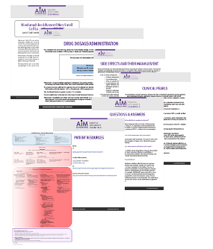
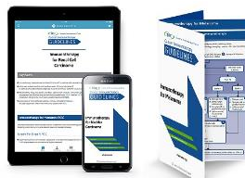
TREAT: Clinical Practice Guidelines

Slide 28
Patient Considerations
Education
Telephone Triage
Different AE profile than chemotherapy
Early recognition of IRAEs is essential to effective treatment
IRAEs are related to the mechanism of action of immunotherapies
IRAEs are treatable and respond well to steroids
Carry wallet card with you at all times
Patients must notify their care provider if they develop symptoms or are admitted to local facility.
Is the patient a reliable and accurate “historian”/
How reliable is the patient to follow telephone instructions?
Comprehension of “sense of urgency”?
Language barriers, Cognitive deficits, Alcohol & Drug use, Co-morbidities?
How far does patient live from clinic? Is there available transportation?
What support or resources does patient have to follow guidelines?

Slide 29
Patient Education Resources
https://www.youtube.com/watch?v=BTrlDgaNyjQ&feature=youtu.be

Slide 30
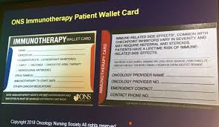
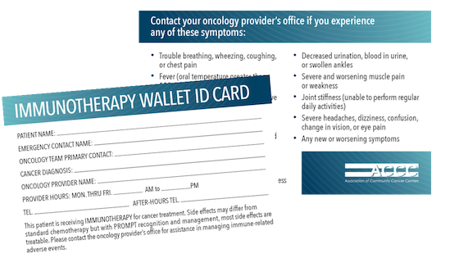
Patient Educational Resources ONS, ACCC
Notes:
Print materials, Classes, Webinars.
AIMwithImmunotherapy: drug specific; customize
Nursing videos, patient videos; CSPs

Slide 31
Patient Educational Resources AIM with Immunotherapy SITC Immuno-Oncology Essentials
Notes:
Print materials, Classes, Webinars.
AIMwithImmunotherapy: drug specific; disease specific, symptom specific: brathing difficulties, cough, diarrhea
ability to customize
Nursing videos, patient videos; CSPs
SITC booklet is more indepth

Slide 32
Strategies to Reduce Acute Care (Handley, 2018)
Strategy | Example Interventions (order of complexity)
Enhance access and care coordination | Reliable mechanisms for patient to contact the care team Improved and standardized care transitions Patient Navigation programs Automated Hovering
Standardized clinical pathways for symptom management | Outpatient symptom management and telephone triage Supportive care ED symptom pathways
Develop urgent care tactics | Flexible scheduling and embedded urgent care Cancer providers embedded in ED Dedicated acute care treatment clinics Dedicated cancer ED
Gaps: CPG based on CTCAE grading. Does not capture full immune toxicity profile
Notes:
Automated Hovering: Optimize access and care coordination; focus on patient-centric engagement facilitated by connected efforts.
Patient reported outcomes: STAR (Symptom Tracking and Reporting); Can expand to telemonitoring to include monitoring of BP etc.

Slide 33
Telephone Triage Guidelines
Provides tool to distinguish which patients can be treated at home and which ones need to come in to clinic
All staff must be educated in use and updates of Telephone Triage guidelines
Early identification of symptoms will minimize severity of adverse events and keep patients on beneficial therapy for longer period of time.
Patient calls with c/o diarrhea
Secretary notifies clinic practice nurse
RN returns call. Triage questions
When did it start
Additional I-O specific symptom questions
Any associated abdominal pain, cramping, nausea or vomiting
How many episodes
Any recent sick contacts
Is the patient able to drink fluids
Any blood or mucous in the stool
If mild:
(increase of < 4 stools per day over baseline), not interfering with ADLs, patient may hydrate PO and take anti-diarrheal agent
If moderate or severe:
not able to maintain fluid intake, or associated with any other sx, patient should come in to clinic for evaluation
Notes:
TRIGGER---Response----Decision Tree Begin grading
Whoever is answering the phone, must be trained in symptom management; Secretaries;
Patients must be educated in role of the triage and what to expect;
Goal is swift management; avoid hospitalization and ER visits.
Need ot develop protocols;
Metrics: standardization of symptom assessment, symptom management
Decrease seriousnsess or intensity of the adverse events.
Goal: reduce ER visits and hospitalizations
I-O toxicities differ.
Staff charged with triaging patient calls need ot be aware of potentially serious adverse events
Educating patients/staff and developing protocols for patient triage/management will ensure Aes are quickly identified , managed and mitigated.
Develop protocols
Patient education
Staff education
Who is answering the phone? Have they been trained?
Patients must also be educated in how the telephone triage system works.

Slide 34
Telephone Triage Guideline Challenges
Onset of IRAEs widely varies & patients are likely to be outside of the clinic upon onset
25% of Emergency Department visits by patients treated with ICPI, due to IRAE (El Majoub, 2018)
CMS Implications: By 2020, hospital penalties for cancer hospitals for patient visits to ED or hospitalizations due to chemotherapy. Rules for ICPI likely to follow.
Patient Considerations
Is the patient a reliable and accurate “historian”/
How reliable is the patient to follow telephone instructions? Comprehension of “sense of urgency”?
Language barriers, Cognitive deficits, Alcohol & Drug use, Co-morbidities?
How far does patient live from clinic? Is there available transportation?
What support or resources does patient have to follow guidelines?
Notes:
TRIGGER---Response----Decision Tree Begin grading
Whoever is answering the phone, must be trained in symptom management; Secretaries;
Patients must be educated in role of the triage and what to expect;
Goal is swift managemntp; avoid hospitalization and ER visits.
Need ot develop protocols;
Metrics: standardization of symptom assessment, symptom management
Decrease seriousnsess or intensity of the adverse events.
Goal: reduce ER visits and hospitalizations
I-O toxicities differ.
Staff charged with triaging patient calls need ot be aware of potentially serious adverse events
Eduating patients/staff and developing protocols for patient triage/management will ensure Aes are quickly identified , managed and mitigated.
Develop protocols
Patient education
Staff education

Slide 35
Key Take Home Points
Toxicities can be life-threatening if not managed promptly
Rapid diagnostic and treatment intervention is imperative for optimal control and prevention of “end-organ” damage
Persistent grade 2 IRAEs and grade 3 or 4 are treated with corticosteroids
Use of standardized algorithms for monitoring and AE management is beneficial
Early discontinuation of steroids may increase risk of relapse or progression of symptoms
Taper of steroids should be under the direct supervision of the health care provider
Re-initiation of treatment may be possible with optimal management
Decision to restart treatment is not always clear

Slide 36
Thank You
QUESTIONS
???

