Slide 1
Incivility in Nursing: Strategies to become an Upstander
Anne M. Ireland, MSN, RN, AOCN, CENP
Executive Director, Community Practice Nursing
City of Hope, Duarte, CA
Director at Large, ONS Board of Directors

Slide 2
Disclosures
Anne Ireland – nothing to disclose

Slide 3
OBJECTIVES
At the end of this session you will be able to:
1. Define Incivility and Bullying
2. Understand the prevalence and consequences of incivility and bullying in nursing
3. Understand the essence of being an “Upstander”
4. Locate tools and resources to support you and your teams in addressing incivility and bullying in your workplace.
5. Recognize the role of LEADERSHIP in eradicating incivility and bullying from the nursing profession.

Slide 4
Nursing Residency Comments
Why can’t you do it on your own?
Why don’t you know this?
You need help? Ask your buddy
Honey, I have a son your age; I know what I’m doing!
It doesn’t make sense to do it that way
I’m too busy to help you…ask someone else
Get to the point
That’s how it has always been done
Come on…that’s Nursing 101!

Slide 5
DEFINITIONS
Incivility: rude and discourteous actions, of gossiping and spreading rumors, and of refusing to assist a coworker.
Bullying: repeated, unwanted harmful actions intended to humiliate, offend and cause distress in the recipient.
“actions taken and not taken”
ANA, Incivility, Bullying, and Workplace Violence, 2015

Slide 7
Let’s poll the Audience
Has it happened to you?
Who was the perpetrator?
Did you ever leave a job because of incivility/bullying?
Have you witnessed other nurses be bullied?
Did you intervene?
Does your organization have a policy on Workplace Incivility/Bullying/Workplace Violence?

Slide 8
Workplace Civility
50% of RNs report being bullied by a peer
42% of RNs report feeling bullied by a person in a higher level of authority
24% of RNs report physical assault by a patient or patient’s family member
Sachs A, et al. 2015. ANA Sets Zero Tolerance’ Policy for Workplace Violence. Bullying.” American Nurses Association.

Slide 9
consequences
Increase Nursing Turnover: (21% overall; 60% of new nurses who resign in the first six months) – Skarbek et al, 2015
Increase likelihood of leaving the nursing profession: (3 times higher) Johnson & Rea, 2009
PTSD: (1 in 5 nurses who were bullied)
Medication errors: 7% of nurses reported a medication error within the past year as a result of intimidation in the workplace – ISMP, 2004
Missed Nursing care Hogh et al, 2017
Contemplated committing suicide: (29%) – Workplace Bullying Institute, 2012

Slide 10
Are You a Bully?
Do you…
Verbally criticize or name-call colleagues?
Sabotage the work of others?
Use ethnic jokes or slurs?
Threaten colleagues?
Play the blame game?
Use intimidation tactics?
Renee Thompson, DNP, RN, CMSRN, Series on Bullying, American Sentinel’s The Sentinel Watch.

Slide 11
Are You a Bully?
Do you ...
Withhold information that may be needed by colleagues to do their jobs?
Exclude others from conversations, projects?
Issue unfair assignments?
Attempt to undermine your colleagues?
Downplay others’ accomplishments?
Renee Thompson, DNP, RN, CMSRN, Series on Bullying, American Sentinel’s The Sentinel Watch.

Slide 12
Joint Commission Standard LD.03.01.01
Leaders create and maintain a culture of safety and quality throughout the (organization)
A4. Leaders develop a code of conduct that defines acceptable behavior and behaviors that undermine a culture of safety.
A5. Leaders create and implement a process for managing behaviors that undermine a culture of safety.
(Applicable to ambulatory care, critical access hospital, home care, hospital, laboratory, long term care, Medicare-Medicaid, certification-based long term care, and office-based surgery programs and behavioral health care programs.)

Slide 13
BYSTANDER EFFECT

Slide 14
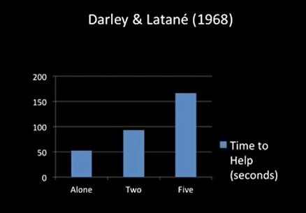
First Bystander Study
Latane, B., & Darley, J. Bystander "Apathy", American Scientist, 1968, 57, 244-268.

Slide 15
Definition: Bystanders
A bystander is someone who sees a potentially harmful situation and does nothing.
A bystander does not protect the values of safety, trust, and honor that are central to our communities.

Slide 16
What would you do?

Slide 17
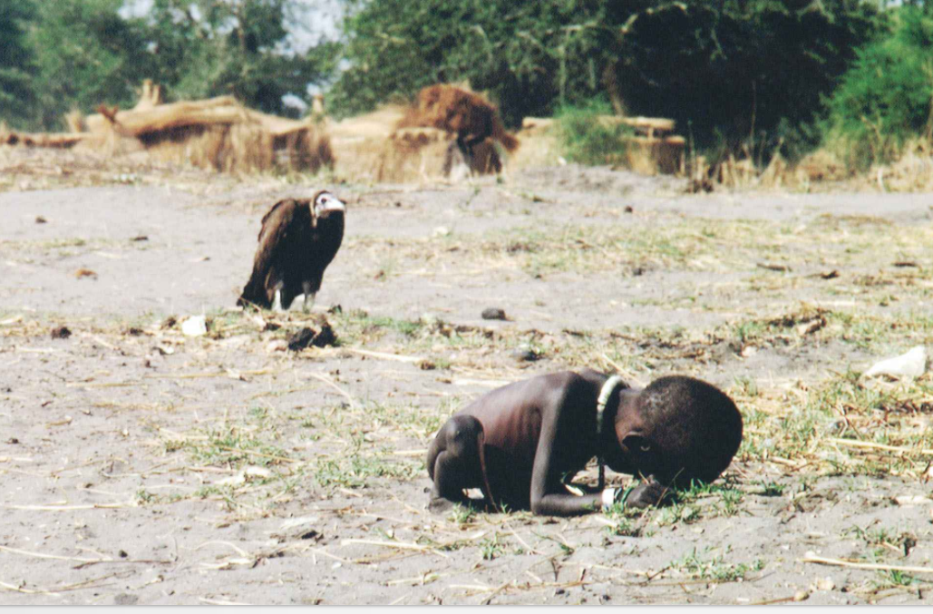
Photo taken by Kevin Carter, South African Photojournalist - Winner of the Pulitzer Prize for Feature Photography, 1994

Slide 18
What Makes us Less Likely to Intervene?
Diffusion of Responsibility
The presence of others may diffuse the sense of individual responsibility (Latane & Darley, 1964)
Ambiguity
In ambiguous situations, people are less likely to offer assistance than in situations involving a clear-cut emergency (Shotland & Heinold, 1985)
Perceived Cost
The likelihood of helping increases as the perceived cost to ourselves declines (Simmons, 1991)
Evaluation Apprehension (Social Inhibition)
We’re afraid we’ll look foolish (Latane & Darley, 1970)

Slide 19
BE AN UPSTANDER

Slide 20
STAND UP!
Don't laugh
Don't encourage the bully in any way
Don't participate
Stay at a safe distance and help the target get away
Don’t become an "audience" for the bully
Reach out in friendship
Help the victim in any way you can
Support the victim in private
If you notice someone being isolated from others, invite them to join you
Include the victim in some of your activities
Tell an adult

Slide 21
Becoming an upsptander looks like this…
Taking action by telling the bully to stop
Taking action by getting others to stand up to the bully with them
Taking action by helping the victim
Taking action by shifting the focus and redirecting the bully away from the victim
Taking action by telling an adult who can help

Slide 22
Being an Upstander
Takes courage
Takes action
Takes assertiveness
Takes compassion
Takes leadership

Slide 25
If you are NOT part of the solution, you ARE part of the problem!

Slide 26
The only thing necessary for the triumph of evil is for good men to do nothing.
Edmund Burke

Slide 27
Triple Filter for gossip
TGU
Is it TRUE?
Is it GOOD?
Is it USEFUL?

Slide 28
MORALITYISNOWHERE

Slide 30
Leading the Way
Crucial conversation
Trusted manager, mentor, etc.
Workplace proclamation
Commitment to My CoWorker
Employee Handbooks requiring employee signature
Zero Tolerance
Don’t be a Bystander, be an Upstander
Strategies/Tools/Programs

Slide 31
Float Survey: The Heavenly Seven
Questions:
I felt welcome on the unit.
Someone offered help when I needed it.
If floated again, I would enjoy returning to this unit.
I had resources I needed to complete my assignment.
I witnessed someone expressing appreciation to another for good work.
Staff showed concern for my well-being.
I received appreciation for my work.
Edmonson, C., & Lee, J (2014). Civility Index dashboard. Retrieved from www.stopbullyingtoolkit.org

Slide 32
Seeking Understanding
Civility Index Dashboard:
Turnover
Intent to stay on the unit: NDNQI Survey
Average tenure
Variance reports for incivility
Float Survey: The Heavenly Seven
Call In
Edmonson, C., & Lee, J (2014). Civility Index dashboard. Retrieved from www.stopbullyingtoolkit.org

Slide 33
Will you be no different or the difference?

Slide 34
TAKEAWAYS
Sadly, incivility and bullying persist in Nursing
If we accept it, we teach it
We must be brave and intervene
We must be UPSTANDERS
We must have ZERO TOLERANCE

Slide 35
MORALITYISNOWHERE CIVILITYISNOWHERE LEADERSHIPISNOWHERE

Slide 37
I have a better idea

Slide 38
Thank you for being the difference, for standing up, for being a leader!
aireland@coh.org

